Slide 1
Basics to R Data Management

Slide 2
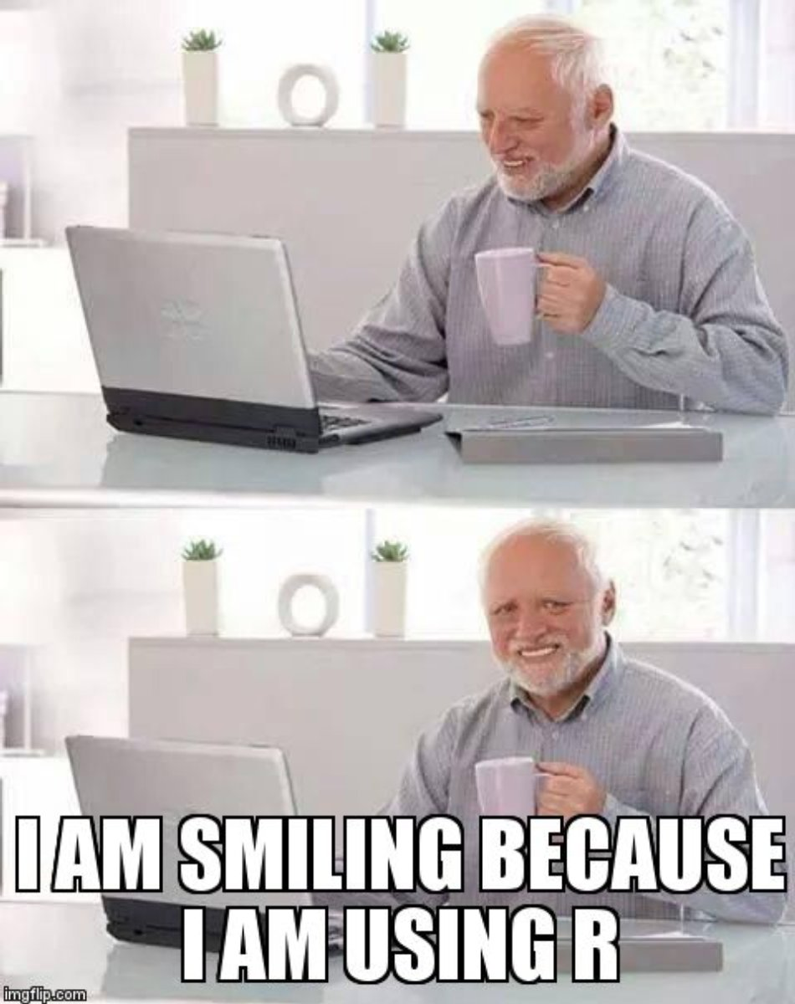
Outline for Today
Schedule Breakdown
Why should you use R?
Learning the Language
Data Management and Descriptive Statistics

Slide 3
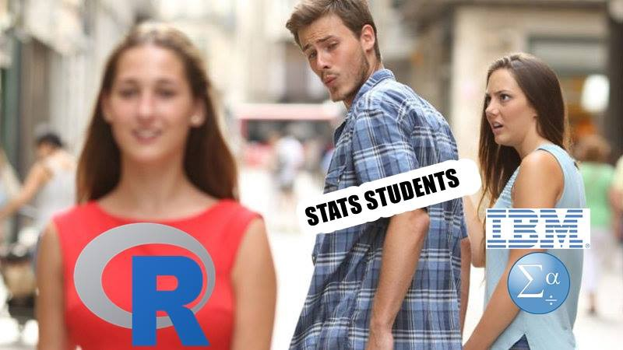
Why Should You Use R?
Flexibility
Cost
Data Visualization
Job Applications
Consistently Updated
Open Science

Slide 4
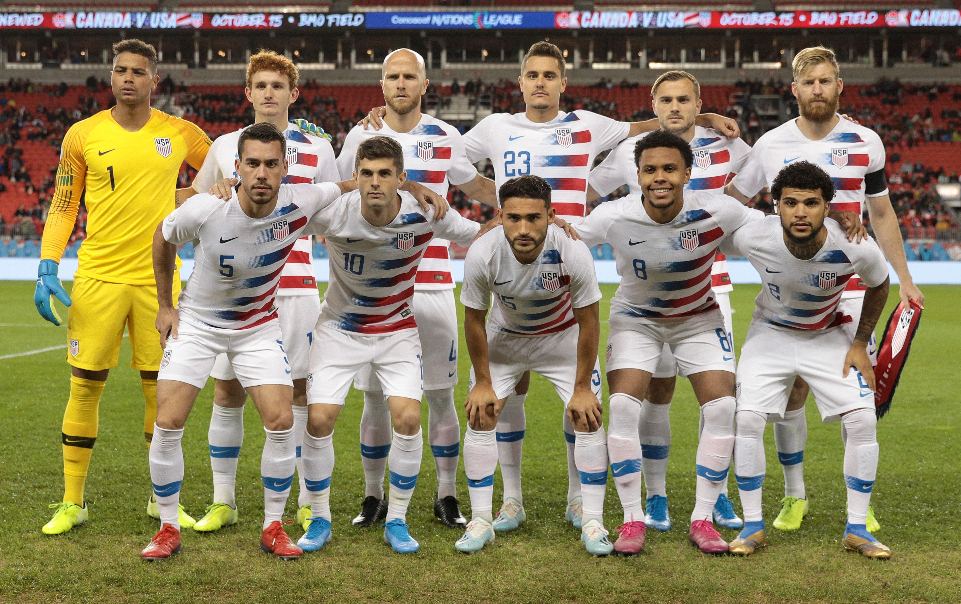
R Language: Skill Levels
Beginner (USA)

Slide 5

R Language: Skill Levels
Intermediate (England)

Slide 6

R Language: Skill Levels
Championship Calibre (France)

Slide 7
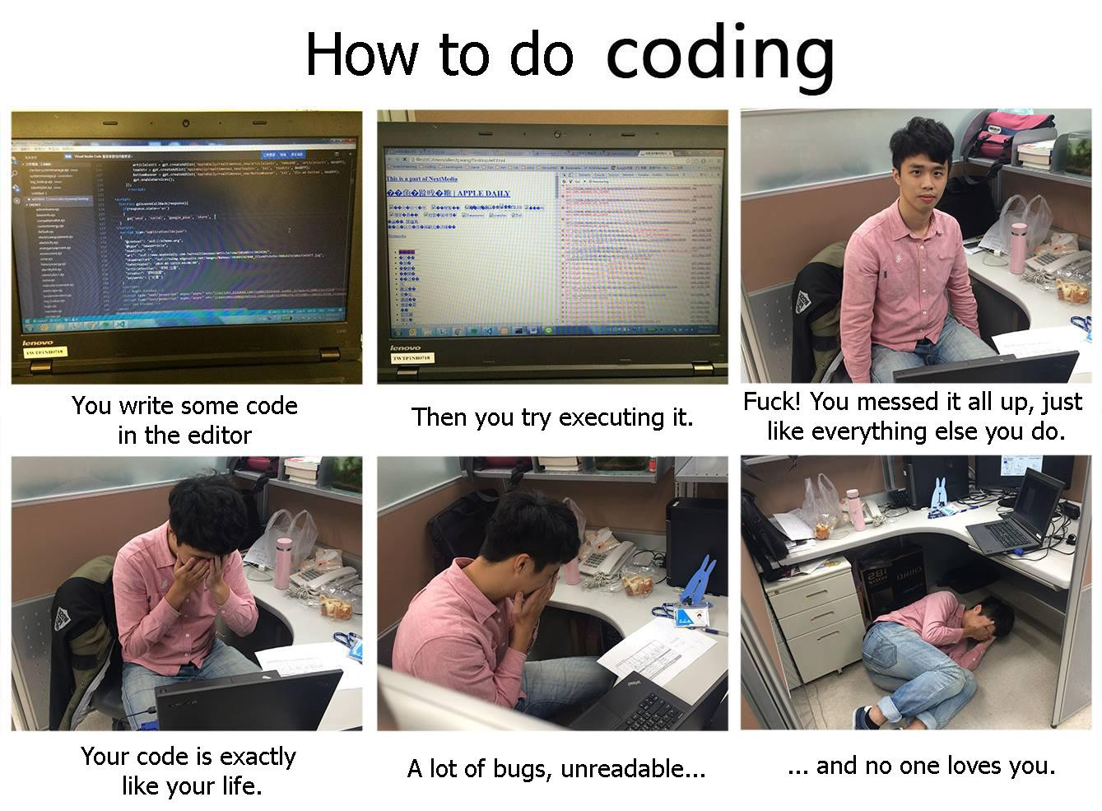

Slide 8
Regardless of your skill level…
Google is your best friend!
Save your code!
Clunky code that works is always better than sophisticated code which doesn’t work
Don’t worry, you will get better with time and practice ☺

Slide 9
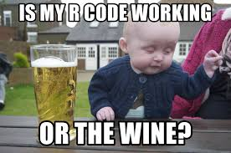
Today’s remaining agenda
Getting started
Data management
Descriptive statistics

